Slide 1
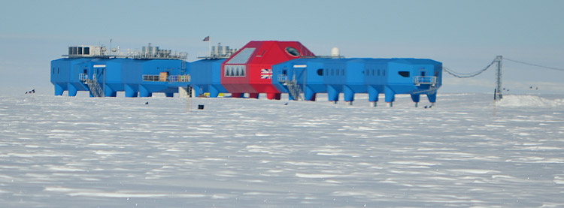
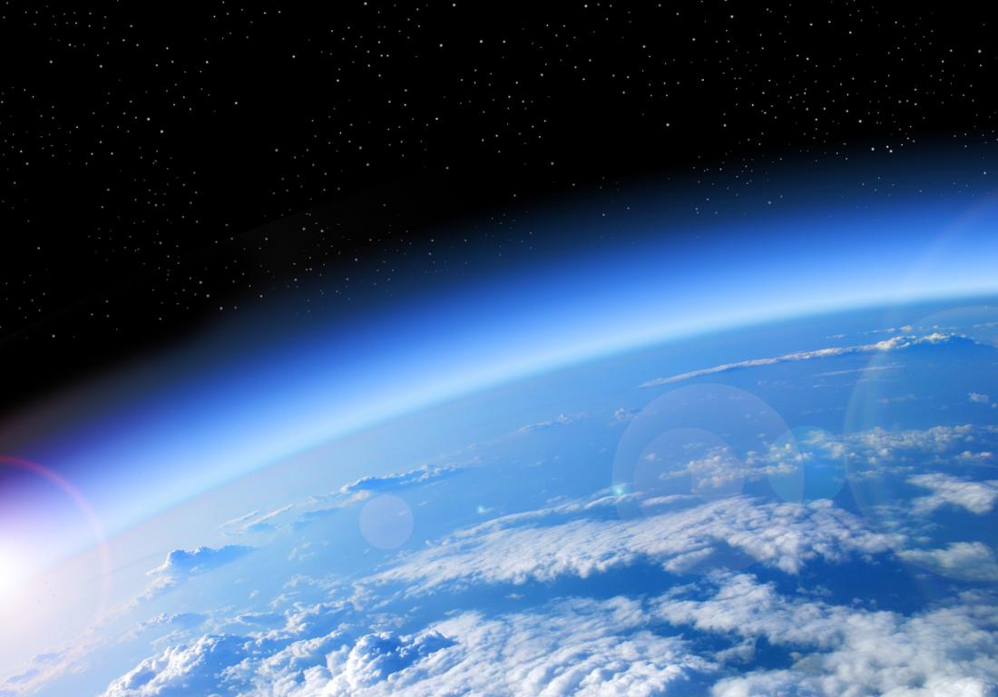
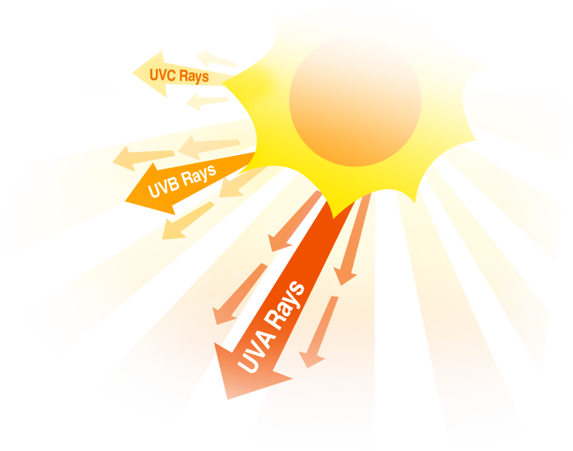
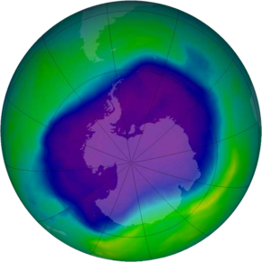
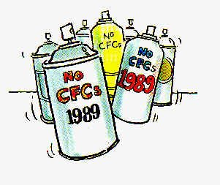
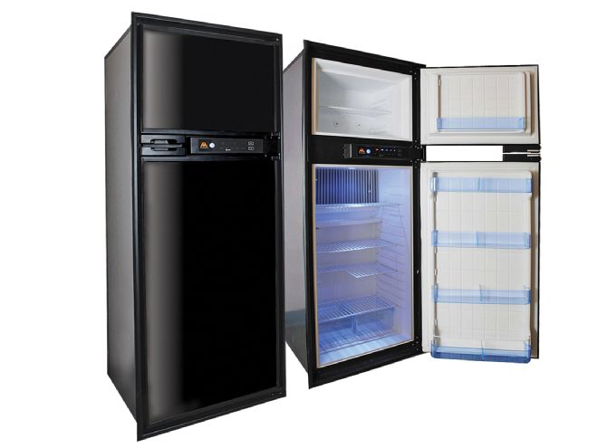
Growth Rates
Identification
Year | Size Of Hole Millions Of km
1980
1985
1990
1995
2000
2005
It was Identified by scientists Joseph Farman, Bruan Gardiner And Johnathan Shanklin in 1984 1000 miles from Halley Bay Base in Antatartica
Haley Bay Arctic Station
3.3
18.8
21.1
26.9
29.9
27.2
Ozone Layer
Indicators and Causes
Ozone Depletion
CFCs Which were found in aerosols and Halons which were found in fridges were the causes
The increased UV radiations at areas above 30˚N
By Tadhg O’Connell Ryan Glynn And Max Merren
Effects
Solutions
- Agree to the Montreal Protocol and keep banning CFC’s and Halons
- Reduce private vehicles as they can cause smog which is a catalyst to ozone depletion
- Ban Nitrous oxide as it is harmful and not covered by the Protocol
-It can Increase the rates of Skin cancer as there is more UV radiation
-Affects Plankton which is bad as it is at the bottom of the food chain and can affect animals higher up
Ozone Hole Over Arctic
Effects of Ozone Depletion

