Slide 1
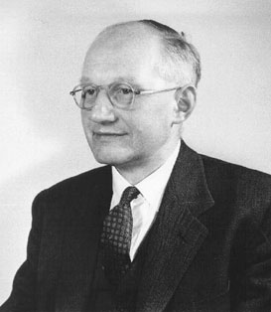
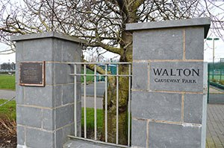
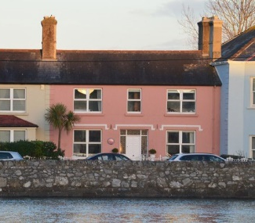
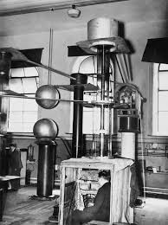
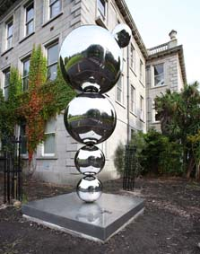
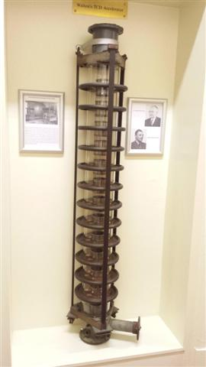
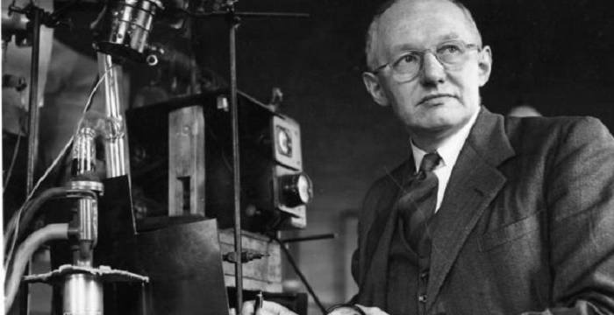
Early Life
Legacy
Ernest Walton was born on October 6th 1903 in Dungarvan County Waterford. He got a scholarship to trinity college where he studied experimental science specialising in physics. Walton achieved his B.S. in 1926. IN He went to Cambridge to work in Cavendish Laboratory in Cambridge under Lord Rutherford.
Walton’s Work led to a huge advance in scientific study. Nuclear fission led to the creation of a new energy source which was Nuclear Energy becoming an energy source that accounts for 11% of the Earth’s power production. It also led to the production of Nuclear bombs that were set off in Hiroshima and Nagaskaki.
Walton Causeway park
Walton's Place of birth
Career
Ernest Walton
When In Caverndish he worked on methods of creating fast particles, working on linear particle accelerators. After Caverndish he returned to Trinity College Dublin. He published works on hydrodynamics microwaves and he was head of the head of the physics department in 1945 and remained there until 1974 when he retired.
Honors
Walton received the Nobel Prize in 1951 for Physics with John Cockroft for splitting the atom in 1951 he was also awarded the Hughes MedaL bY The Royal Society of London “their Discovery that nuclei could be disintegrated by artificially produced bombarding particles. He also had a monument designed in his honor that is in Trinity College Dublin.
Walton Monument
ww
Major Works
Walton’s Major Work was the splitting of the atom. Along with Cockroft he designed machine to accelerate protons he then bombarded a lithium atom with accelerated protons. The Atom was split in two and produced two alpha particles. This was the first time this had been ever been done and led to the verification of Einstiens equation E= MC2.
Later Life

